Slide 1
SENTIMENT ANALYSIS PROJECT “DEPI”
Abdelrahman Badway – Hussen Sabry – Hussein Reda
Shadi Moustafa – Menna Nasr
Under supervision of: Eng. Aya Hisham

Slide 2
OUTLINE
01
03
PREPARE ENVIROMENT
BUSNIESS PROBLEM
02
INTRODUCTION
04
DATA GATHERING

Slide 3
OUTLINE CONT.
DATA PREPROCSSING
ARTIFICAL INTELLIGENCE
05
07
06
DATA ANALYSIS
08
DEPLOYMENT

Slide 4
BUSNIESS PROBLEM
01

Slide 5



BUSNIESS PROBLEM
Instead of Reading thousands of comments Our team concluded that sentiment analysis will be our best option so we can analyze the data and give feedback whether it’s positive or negative.
Sentiment analysis helps many organizations such as: Twitter(X), Ministry of communication, Companies of communications etc. …

Slide 6
INTRODUCTION
02

Slide 7
“Brand sentiment analysis aims to gauge and quantify public attitudes toward a brand at any given point in time”.
—OUR TEAM.

Slide 8
INTRODUCTION
Through the whole journey of knowing the requirements, searching and finding out that we should look more further in:
Data Preprocessing.
Machine Learning concepts.
NLP ”Natural Language Processing” Models.
Deployment.

Slide 9
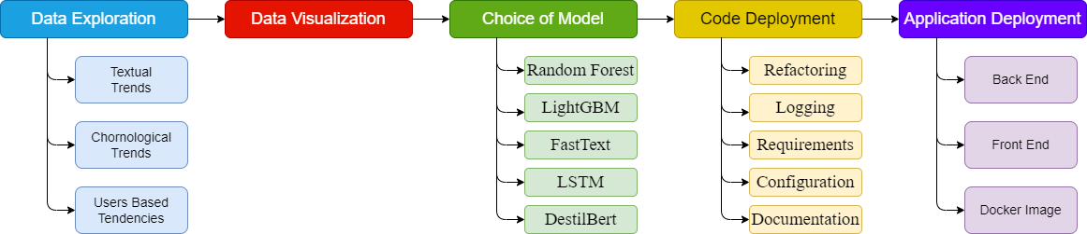
PIPELINE

Slide 10
ENVIROMENT SETUP
03

Slide 11



ENVIROMENT SETUP
So, we used multiple tools to setup our environment
Such as:
Python:
Numpy.
Pandas.
Matplotlib.
Bytorch.
GitHub.
Docker.

Slide 12
DATA GATHERING
04

Slide 13


WHY DID WE PICK THIS DATASET?
We initially considered web scraping but ultimately we chose to focus our efforts on developing machine learning models. As a result, we relied on a Kaggle dataset for our analysis.

Slide 14
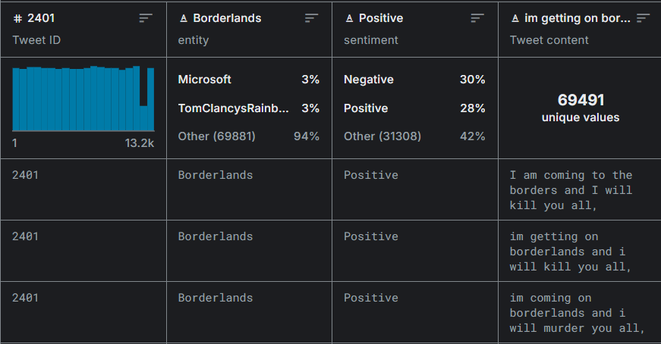
ABOUT DATA
Data Shape:
5 Columns: “Target”, “ID”, “Date”, “Query”, “User”, “Text”.
1,600,000 Rows.
About Data:
This is an entity-level sentiment analysis dataset of twitter. Given a message and an entity, the task is to judge the sentiment of the message about the entity. There are two classes in this dataset: Positive and Negative.
Data Link:
https://www.kaggle.com/datasets/raj713335/twittesentimentanalysis

Slide 15
DATA PREPROCSSING
05

Slide 16
DATA PREPROCESSING
TEXT ANALYSIS
TIME ANALYSIS
USER ANALYSIS
To help us in NLP “Natural Language Processing” model.
To track the user behavior according to time series.
To know more about user behavior.

Slide 17
DATA PREPROCESSING
Create tokens “Tokenization for”:
Word.
Users
Hashtags.
URLs.
Create “Ngrams”.
Convert the tweets to lower case.
Splitting Hashtags and Mentions. “#”, “@”.
Time Analysis.
User Analysis.

Slide 18
DATA PREPROCESSING CONT.
Stop word removal:
Stopwords are common words that add little value in NLP tasks (e.g., "the", "and", "is"). Removing them reduces noise and improves model performance. We used NLTK to remove stopwords.

Slide 19
DATA VISUALIZATION
Users.
Mentions.
Hashtags.
URLs.

Slide 20
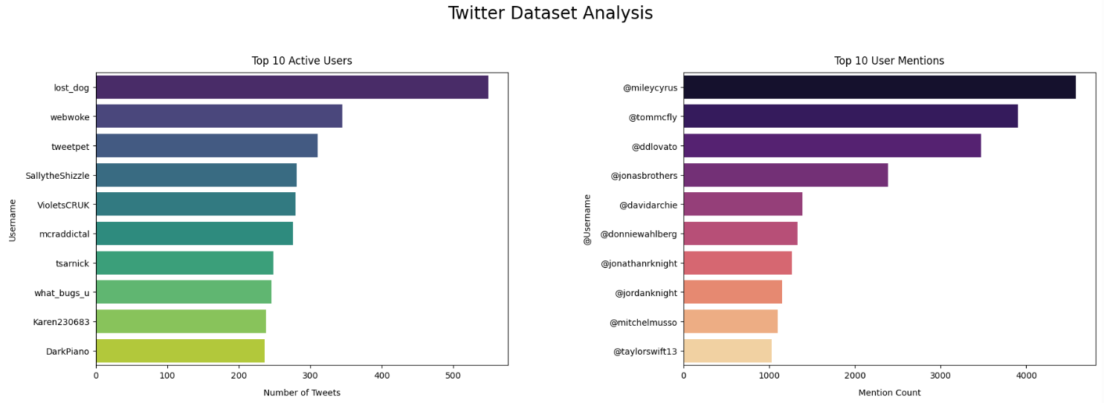
DATA VISUALIZATION
Top 10 active users:
lost_dog
webwoke
tweetpet
sallytheShizzle
violetsCRUK
mcraddictal
Tstanick
what_bug_u
Karen230683
DarkPiano

Slide 21
DATA VISUALIZATION
Top 10 user mentions:
@mileycyrus
@tommcfly
@ddlovato
@jonasbrother
@davidarchie
@donnieahlberg
@jonathanrknight
@jordanknight
@mitchelmusso
@taylorswift13

Slide 22
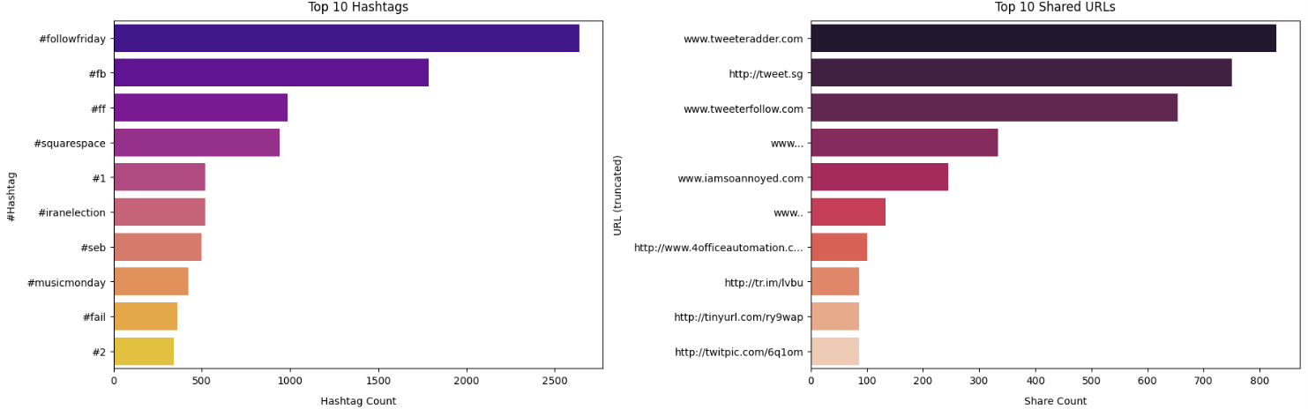
DATA VISUALIZATION
Top 10 Hashtags:
#followfriday
#fb
#ff
#sqaurespace
#1
#iranelection
#seb
#musicmonday
#fail
#2

Slide 23
DATA VISUALIZATION
Top 10 Shared URLs:
www.tweetradder.com
http://tweet.sg
www.tweeterfollow.com
www…..
www.iamsoannoyed.com
ww..
http://www.4officeautomation.com
http://tr.im/ivbu
http://tinyurl.com/ry9wap
http://twitpic.com/6q1om

Slide 24
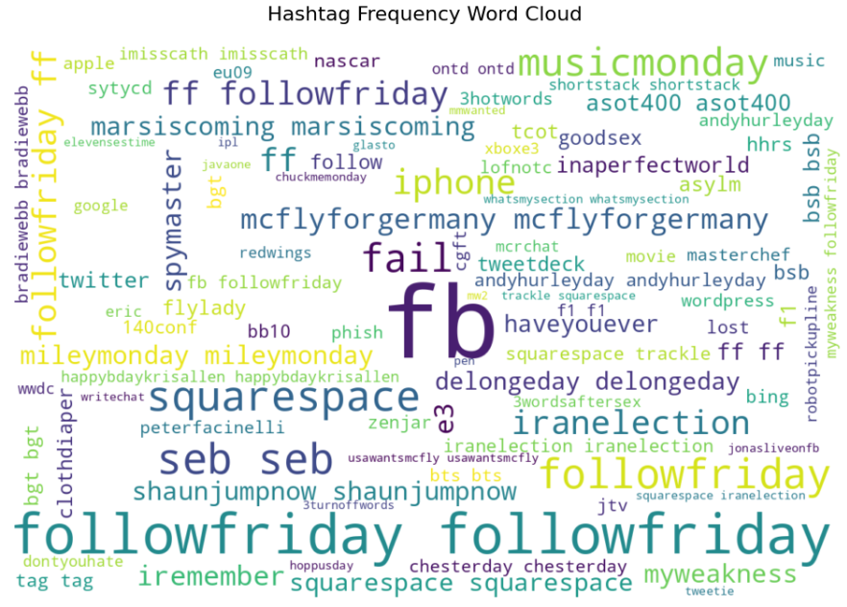
DATA VISUALIZATION
The hashtag with the highest frequency is:
fb

Slide 25
DATA VISUALIZATION
Histogram (Distribution).
Bar plot or Count plot.
Word cloud for positive.
Word cloud for negative.
Boxplot.

Slide 26
DATA PREPROCESSING CONT.
Data analysis:
Words.
Bigram.
Data visualization:
Words.
Bigram.

Slide 27
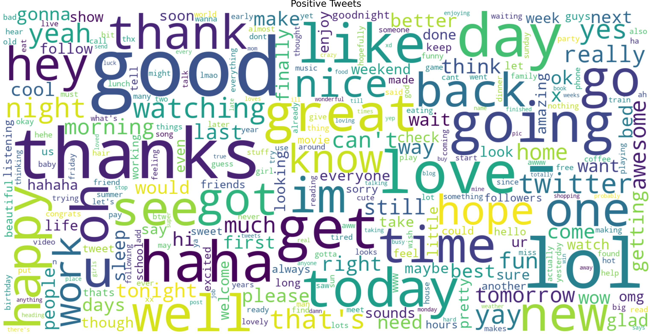
WORD CLOUD FOR +IVE

Slide 28
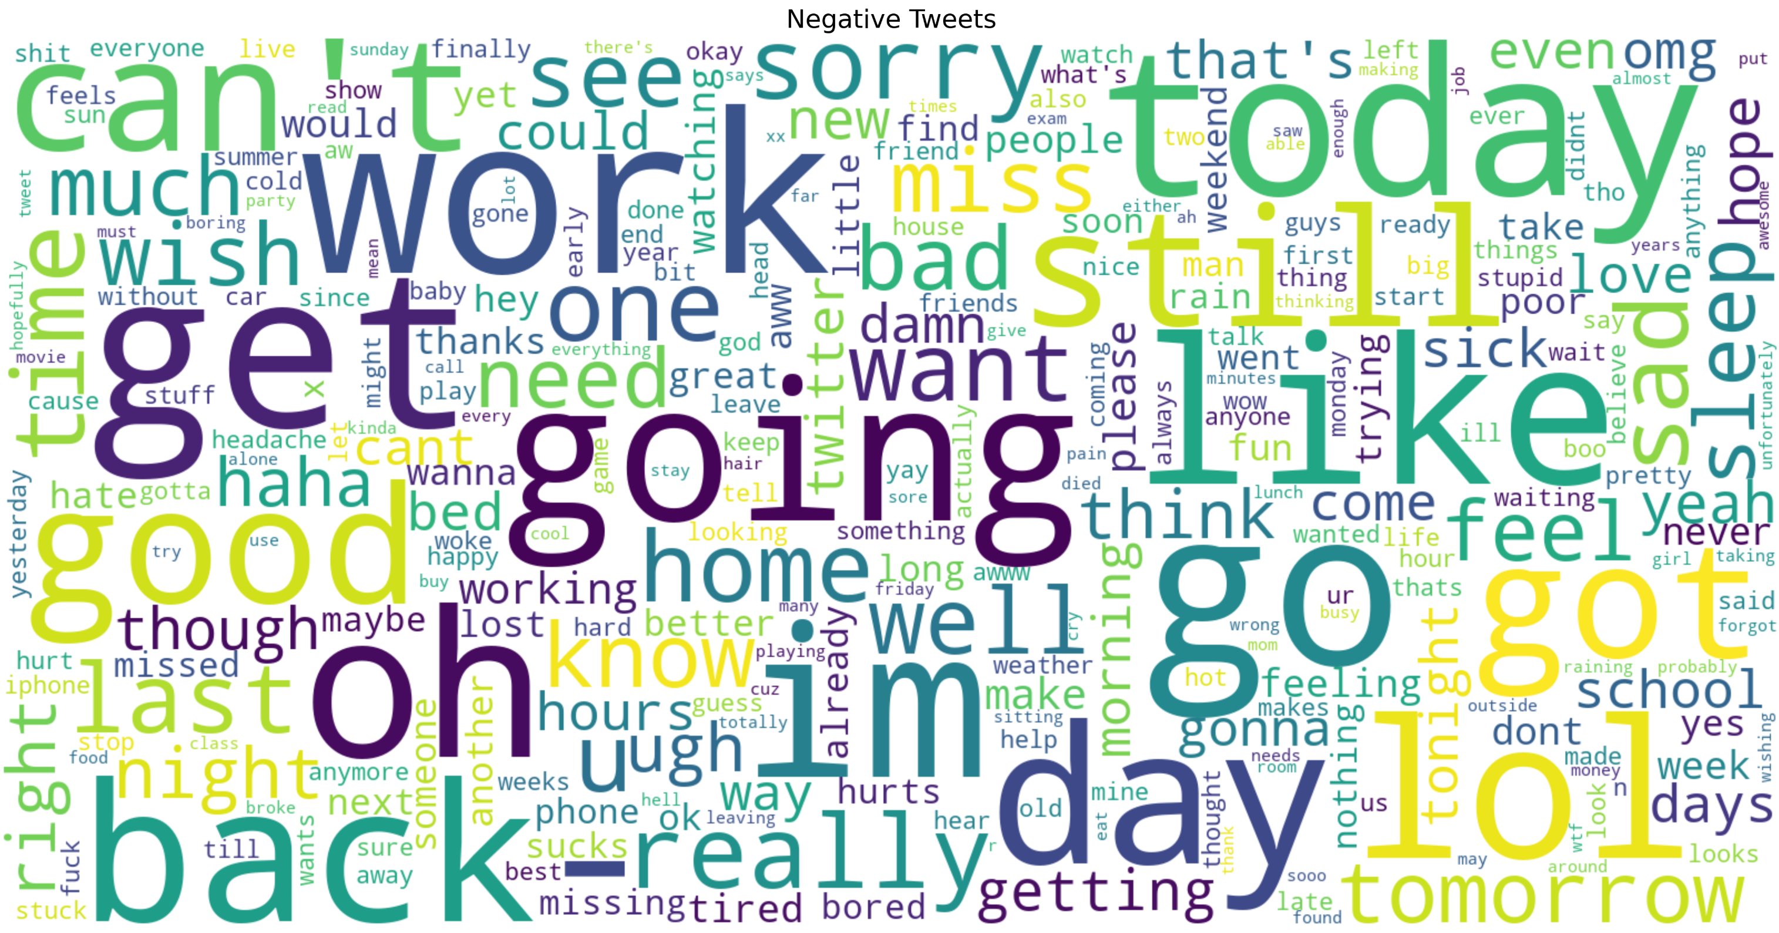
WORD CLOUD FOR -IVE

Slide 29
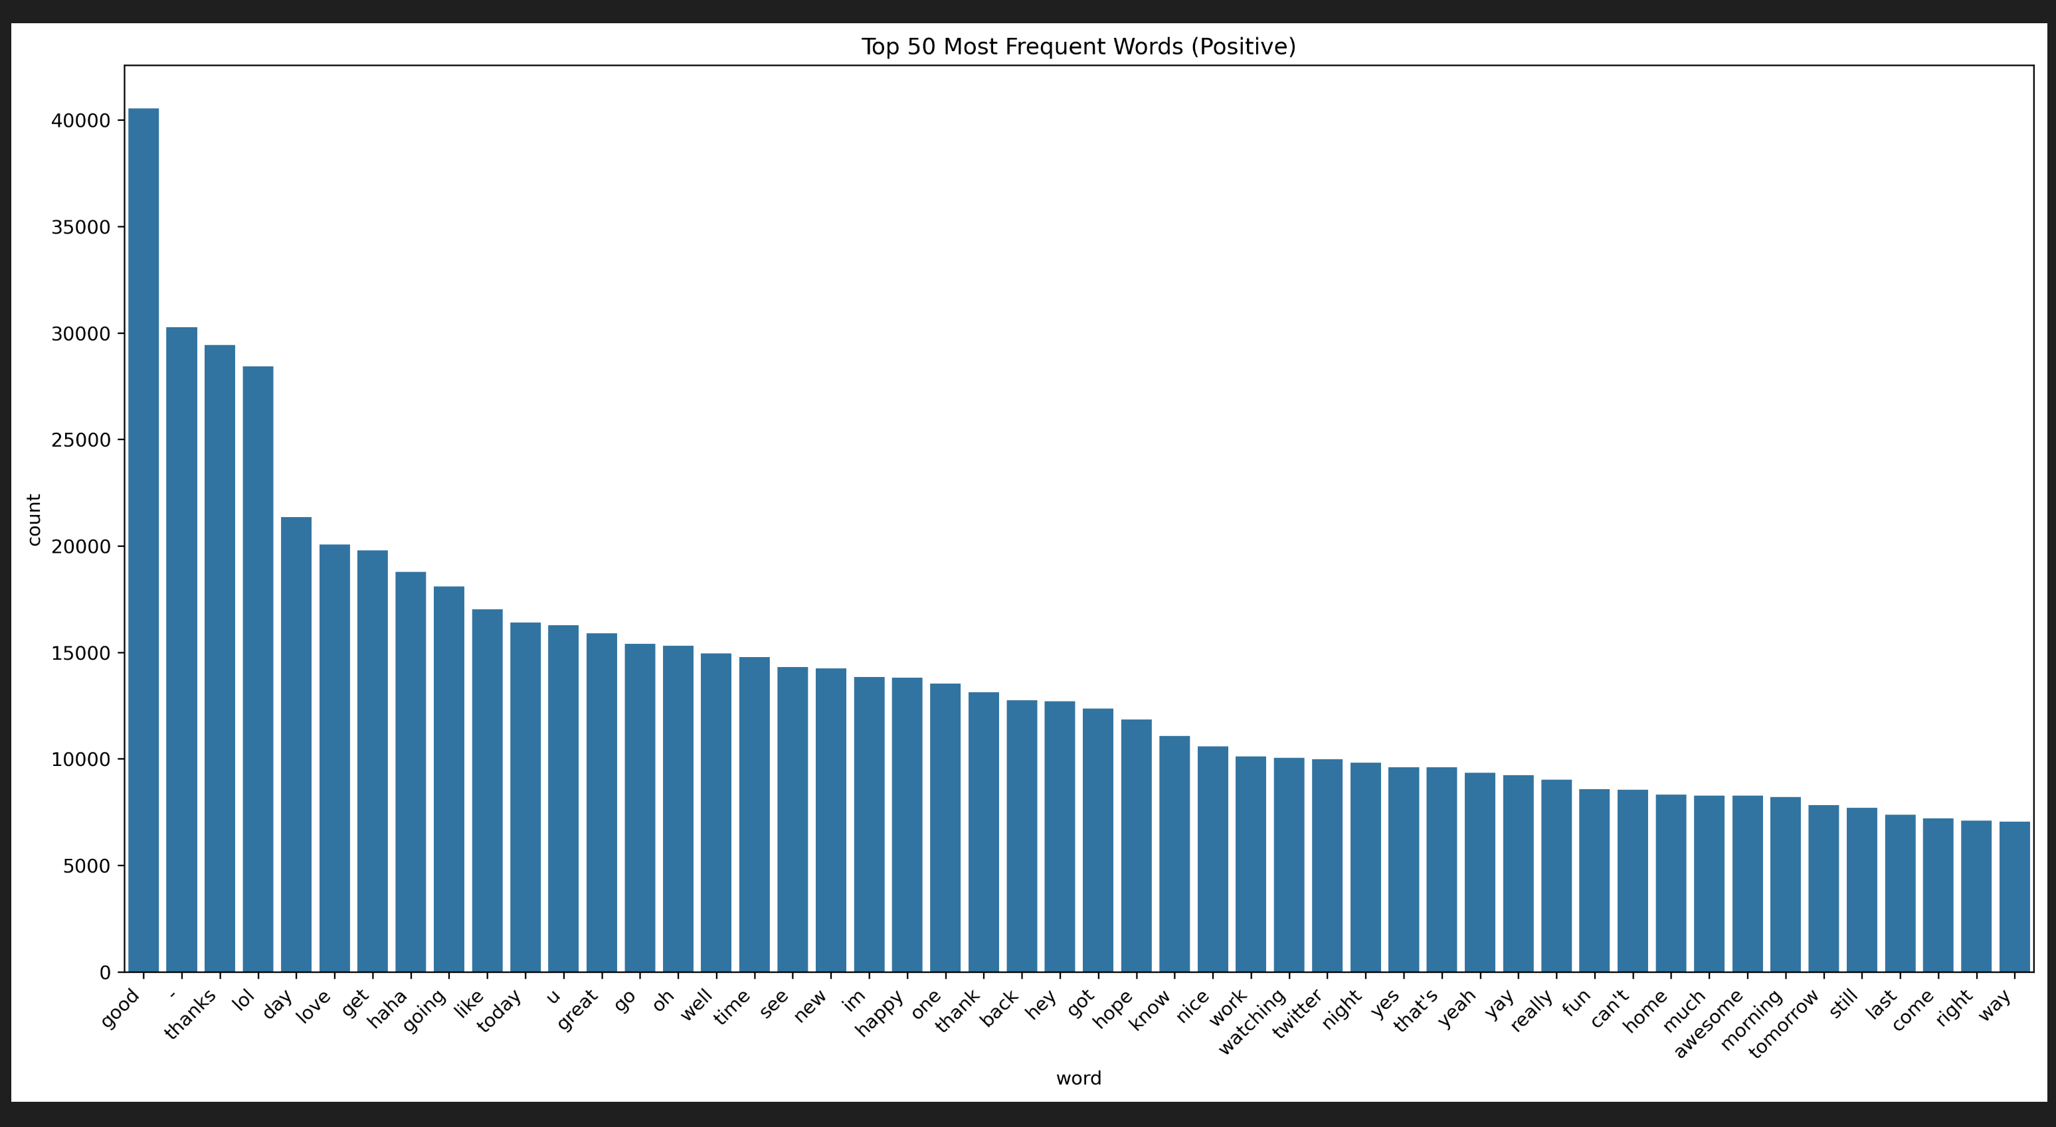
DATA PREPROCESSING CONT.
Top 50 positive words.
The most positive frequent words are:
Good
-
Thanks
Lol
Day

Slide 30
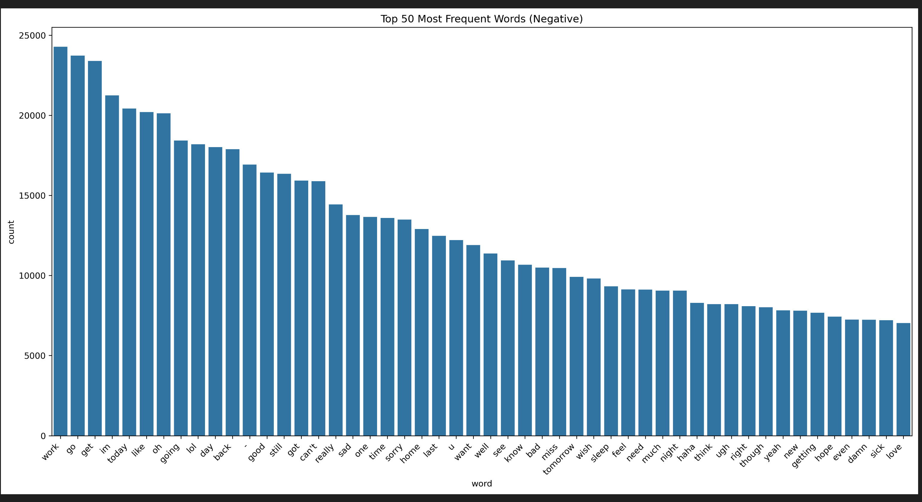
DATA PREPROCESSING CONT.
Top 50 negative words
The most negative frequent words are:
work.
go.
get.
Im.
today

Slide 31
ARTIFICIAL INTELLIGENCE MODELS
07

Slide 32
NOTE !
This was our first time working on NLP models that’s why we used:
Random Forest (Classical Machine Learning Model).
LightGBM (Classical Machine Learning Model).
FastText (Hypermodel “Classical & Deep Learning Model”).
LSTM (RNN “Deep Learning”).
Distilbert (Transformer based deep learning).

Slide 33
Performance Comparison
Model | Total Training Time | Accuracy
LightGBM | 10 Minutes | 49.84%
Random Forest | 3 Hours | 73.74%
FastText | 3.5 Minutes (3 Epochs) | 78.80%
LSTM | 15 Hours (2 Epochs) | 79.41%
DestilBert | 33 Hours (3 Epochs) | 86.90%
Note that each implementation ran on different environment with different hardware. The times shown doesn’t accurately represent model performance.

Slide 34
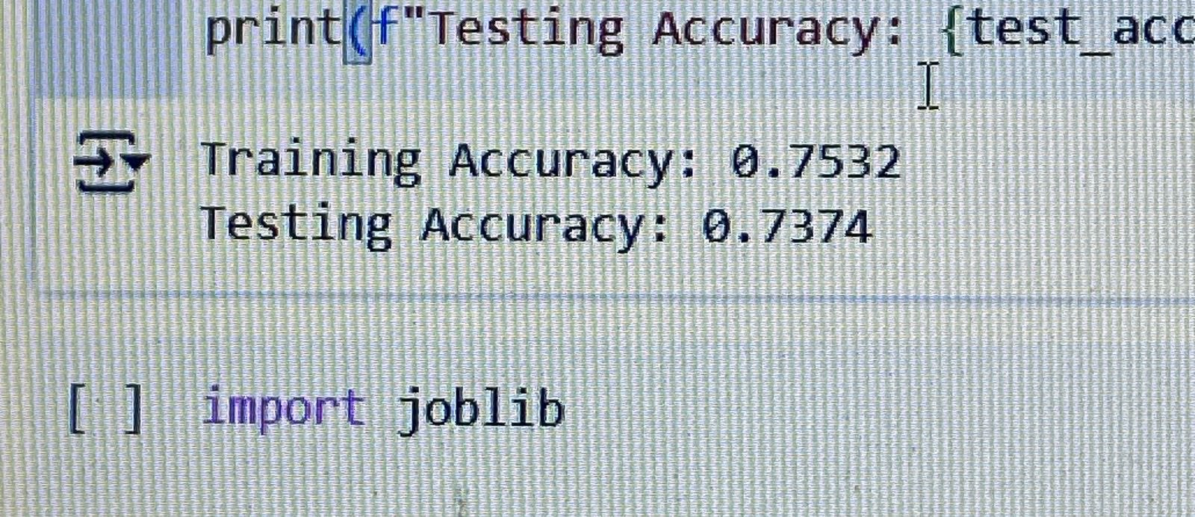
Random Forest
Ensemble learning method using multiple decision trees.
Good for tabular data, fast training, but limited for text.
Requires vectorization (TF-IDF, CountVectorizer).
Why DistilBERT over Random Forest?
Random Forest fails to capture context in text.
DistilBERT is pretrained on massive corpora.
Better at understanding semantics, syntax, and nuance.
Especially useful for large text data.

Slide 35
LIGHTGBM
“Light Gradient Boosting Machine”
It’s designed for efficiency, scalability and high accuracy particularly with large datasets.
It uses decision trees that grow efficiently by minimizing memory usage and optimizing training time.
Key innovations like:
Gradient-based One-Side Sampling (GOSS).
Histogram-based algorithms.
Leaf-wise tree growth.
Those innovations enable LightGBM to outperform other frameworks in both speed and accuracy.

Slide 36
LIGHTGBM DATA STRUCTURE
The LightGBM Data Structure API provides tools for managing data in machine learning workflows using LightGBM. It includes:
lightgbm.Dataset: Core data structure for storing training and validation data, supports preprocessing and feature handling.
lightgbm.Booster: Represents a trained model and provides methods for prediction, saving/loading models, and accessing training results.
lightgbm.CVBooster: Stores models from cross-validation folds and aggregates results.
lightgbm.Sequence: Utility for handling large datasets that don't fit in memory, useful for batch-wise training.

Slide 37
LIGHTGBM Core Parameters
LightGBM's core parameters shape model structure and optimization:
objective: Defines the loss function (e.g., regression, binary, multiclass).
task: Specifies whether to train or predict (default: train).
num_leaves: Max number of leaves per tree; higher values capture more complexity.
learning_rate: Controls learning speed; lower values improve generalization.
max_depth: Sets tree depth limit.
min_data_in_leaf: Minimum samples per leaf; prevents overfitting.

Slide 38
LIGHTGBM Core Parameters cont.
LightGBM's core parameters shape model structure and optimization:
num_iterations: Number of training iterations (default: 100).
feature_fraction: Fraction of features used per tree; promotes diversity.
bagging_fraction: Fraction of data used for bagging; adds randomness.
L1/L2: Regularization terms to reduce overfitting.
min_split_gain: Minimum gain needed to split a node.
categorical_feature: Identifies categorical features for training.

Slide 39
LIGHTGBM Boosting Algorithms
LightGBM Boosting Algorithms uses:
Gradient Boosting Decision Trees (GBDT): builds decision trees sequentially to correct errors iteratively.
Gradient-based One-Side Sampling (GOSS): samples instances with large gradients, optimizing efficiency.
Exclusive Feature Bundling (EFB): bundles exclusive features to reduce overfitting.
Dropouts meet Multiple Additive Regression Trees (DART): introduces dropout regularization to improve model robustness by training an ensemble of diverse models.

Slide 40
LIGHTGBM PROS
High Speed and Efficiency
LightGBM is optimized for fast training through histogram-based algorithms aLightGBM is optimized for fast training through histogram-based algorithms and parallel learning.nd parallel learning.
Excellent Performance
Often delivers high accuracy with lower training time compared to other gradient boosting methods (e.g., XGBoost, CatBoost).
Built-in Handling of Categorical Features
Automatically handles categorical variables without the need for one-hot encoding.
Low Memory Usage
More memory-efficient due to its histogram-based algorithm and leaf-wise tree growth.
Scalability
Capable of handling large datasets efficiently and supports distributead training.
Support for GPU Acceleration
Can leverage GPUs to significantly speed up model training.
Flexibility
Supports various tasks like regression, classification, ranking, and more with multiple objective functions.

Slide 41
LIGHTGBM CONS
Overfitting Risk
Leaf-wise tree growth can lead to overfitting, especially with small datasets.
Less Interpretable
Like other ensemble models, LightGBM models can be complex and difficult to interpret.
Sensitive to Parameter Tuning
Requires careful hyperparameter tuning to achieve optimal performance and avoid overfitting.
Limited Native Support for Sparse Data
May not perform as well as models like CatBoost with sparse or highly imbalanced data unless properly tuned.
Preprocessing Required
Although it handles categorical data, other types of preprocessing (e.g., missing values, normalization) may still be needed for best results.

Slide 42
FAST TEXT
Word2Vec (by Google) – early word embedding model.
NLP Model.
Facebook production.
Uses:
Chatbot.
Search engine.
Correct typos.
Supports words even if they miss some characters.
Types:
Text Classification.
Supervised.
Output has label
Used as model machine learning
Word embedding.
Divides words into subwords and place them into vectors.
Unsupervised.
Only deals with tweets.
The vectors outputs are used in prediction of another model.

Slide 43
FAST TEXT CONT.
1. Word Embedding
Definition:
Transforms each word into a numeric vector, capturing semantic meaning.
2 Types:
Skipgram.
Cpow “Continous back of words”.

Slide 44
FAST TEXT CONT.
2. Text Classification
Definition:
Predicting labels for text using supervised learning.
Types:
Multiclass Classification:
One label per input.
Example: Sentiment → positive, neutral, or negative.
Multilabel Classification:
Text can belong to multiple classes simultaneously.
Example: Tweet → both sports and politics.
# Use Case:
Pre-trained word embeddings like Word2Vec or FastText can be used as input features for text classification models (e.g., LSTM, CNN, BERT, etc.).

Slide 45
FAST TEXT CONT.
3. Pre-trained Models
Why use them?
Save time and computation.
Trained on billions of words.
Trained on 150 language.
Examples:
FastText (Facebook)
Word2Vec (Google)
BERT (Google)

Slide 46
"lay"
FAST TEXT CONT.
What Are n-grams?
n-grams = consecutive sequence of “n” items from text.
Word-level n-grams:
Unigram: one word (e.g., "play”)
Bigram: two consecutive words (e.g., “play football”)
Trigram: three words (e.g., “play football today”)
Character-level n-grams (used by FastText):
For word “play” → “pl”, "pla“, “lay”.
Helps in understanding subword information and OOV handling.

Slide 47
FAST TEXT CONT.
Pros:
Supports incomplete words.
Suitable for low GPU specification.
support [oov] by using character-n-grams.
Good in derived words.
Fast performance, faster than Bert but on accuracy.
Pretrained model.
Cons:
Don’t understand the main meaning of sentence concept.
Depend on word not for all sentence
Dont understand the derived words
Accuracy is Bad 76 %

Slide 48
LSTM
Introduction to NLP: If we want to make our computer understands the words but not like humans.
Then NLP will convert the text to vector of numbers.
Step to NLP:
Preprocessing.
Representation (Convert to numbers):
Embedding.
TF_IDF.
Count Vector.
Contextual embedding (Like BERT).
Modeling.

Slide 49
LSTM CONT.
The meaning of embedding:
We represent word with a numeric space such as:
Vector(king) is more closed to vector(queen)
And the vector (sad) is opposite to the vector (happy).
The two famous types of embedding:
Fast Text is learning to represent the word from the context (word 2 VEC) but merge the embedding letter.
BERT (Transformer based): Take the full context before and after the word into consideration.

Slide 50
LSTM CONT.
LSTM is a type of RNN that was designed to solve the problem of vanishing gradient.
How to represent to design LSTM RNN.
Preparing tokenizer and train it on the text (Integer encoding).
Apply the prelearned tokenizer on tweets using tokenizer.text_to_sequence.
The part of padding and truncate.
Going to train, test, split, feature selection and feature engineering.
Built sequential LSTM model.
# We used the at dense layer (relu) to protect the model from vanishing gradient.
# And in output layer we used sigmoid function.

Slide 51
Distil Bert
Embedding Distil Bert:
Words and Subwords. [Encodings are pretrained]
Segment encoding (Number of sentence).
Positing of words (Number of word).

Slide 52
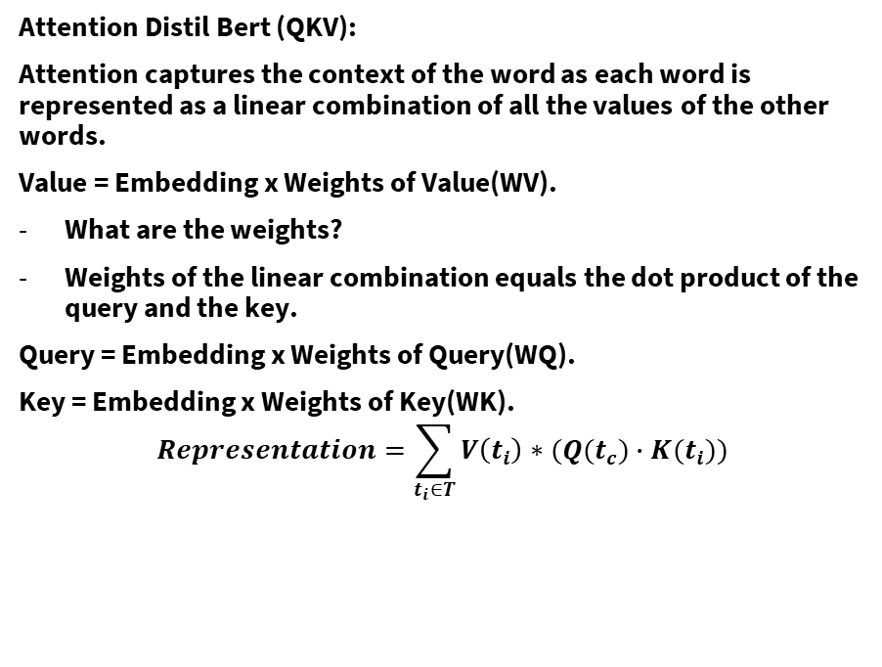
Distil Bert
Attention Distil Bert (QKV):
Attention captures the context of the word as each word is represented as a linear combination of all the values of the other words.
Value = Embedding x Weights of Value(WV).
What are the weights?
Weights of the linear combination equals the dot product of the query and the key.
Query = Embedding x Weights of Query(WQ).
Key = Embedding x Weights of Key(WK).
$$Representation=\sum_{t_{i}∈T}{V\left(t_{i}\right)∗(Q(t_{c})∙K(t_{i}))}$$

Slide 53
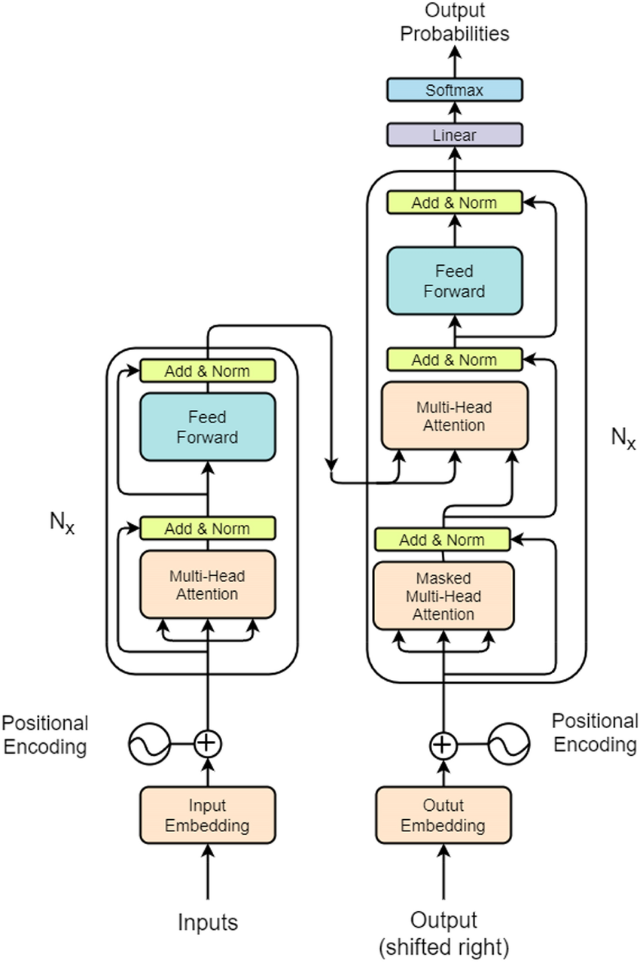
Distil Bert
Transformers Distil Bert:
A combination of an encoder and a decoder.
An encoder is a series of repeating blocks (Attention layer + Feed Forward neural network)
The final attention layer supplies the Queries and the Keys.
In the decoder a set of values of the output space is used to compute the result encoding.
Decode the representation to obtain the output.

Slide 54
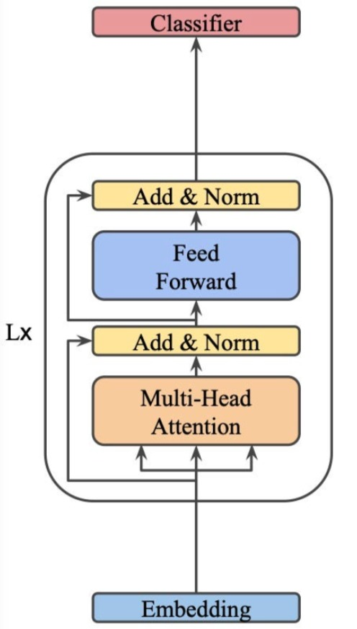
Distil Bert
Why Distil BERT?
A type of encoder. (Bidirectional Encoders representations of transformers.)
In Bert a token [CLS] is added at the beginning of the sentence.
The representation of the [CLS] token is the features for the classification.
EX. [CLS] This is good. [SEP] I felt excited.
Features are fed to a fully connected layer.
Parameters to train: Embeddings, QKV weights for each Iteration [6 for DestillBERT], Classifier.
We give the option to fully train all the parameters, or –By default – The final attention / FFN layer + the classifier.

Slide 55
NOTE !
Random Forest (Classical Machine Learning Model).
LightGBM (Classical Machine Learning Model).
fastText (Hypermodel “Classical & Deep Learning Model”).
LSTM (RNN “Deep Learning”).
Distilbert (Transformer based deep learning).
# We chose Distilbert.

Slide 56
DEPLOYMENT
08

Slide 57
DEPLOYMENT
IN BOTH FRONT & BACK END: We used flask
API: It’ll be predicting how much confidence whether it’s positive or negative.
Built using Flask and structured via Blueprints.
Endpoint: POST /predict.
Accepts JSON with list of tweets → returns sentiment labels.
Integrated with trained DistilBERT model.
Includes:
Input validation.
Logging (debug mode).
GET /healthz for status checks.
Front End: This where the back end will receive our request.
Docker: We have also used docker.

Slide 58
¡GRACIAS!
Por favor, conserva esta diapositiva para atribuirnos

